Slide 1
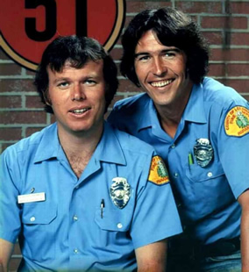
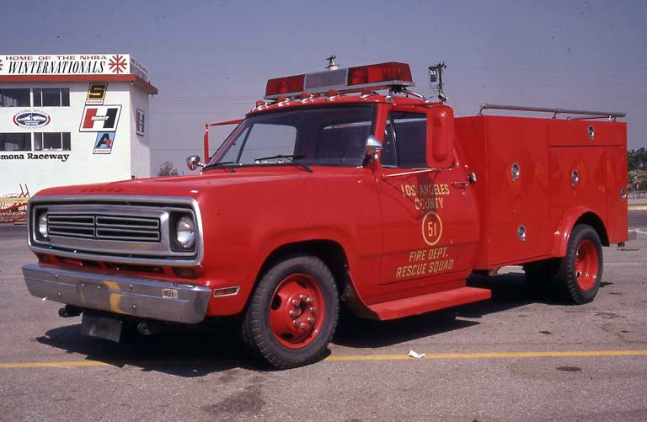
Emergency

Slide 2
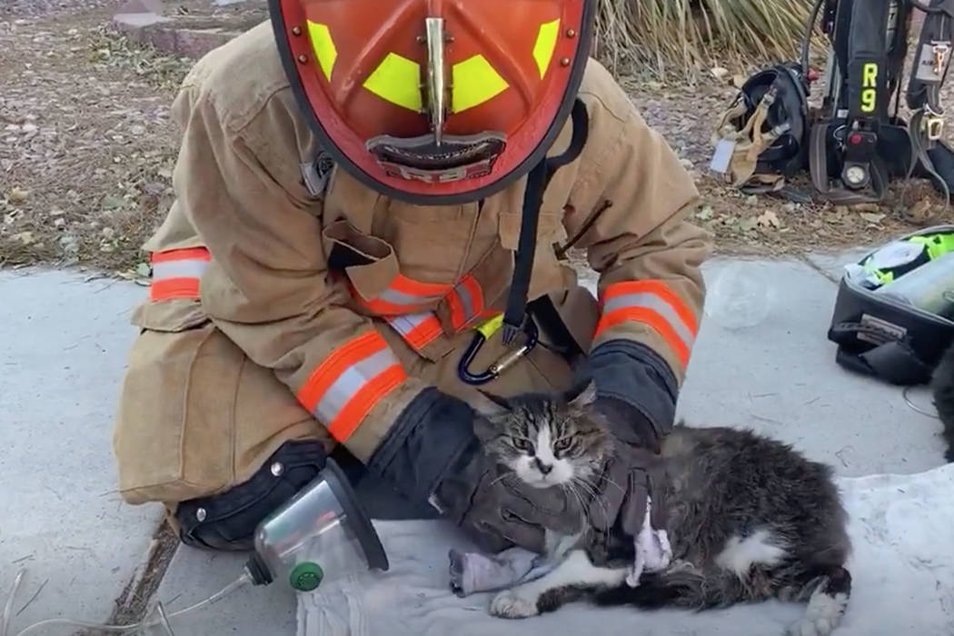
Each emergency situation has a corresponding code.
It is essential to know these codes and the actions to be taken.

Slide 3

Code Blue – Medical - 911
Code Red – Fire/Chemical - 911
Code Alpha – Active Shooter - 911 Evacuate
Code Nemo – Lost Child - Lock Down
Code Black – Civil Unrest - Lock Down
Code Orange – County Order Lock Down
Code Green – All Clear

Slide 4

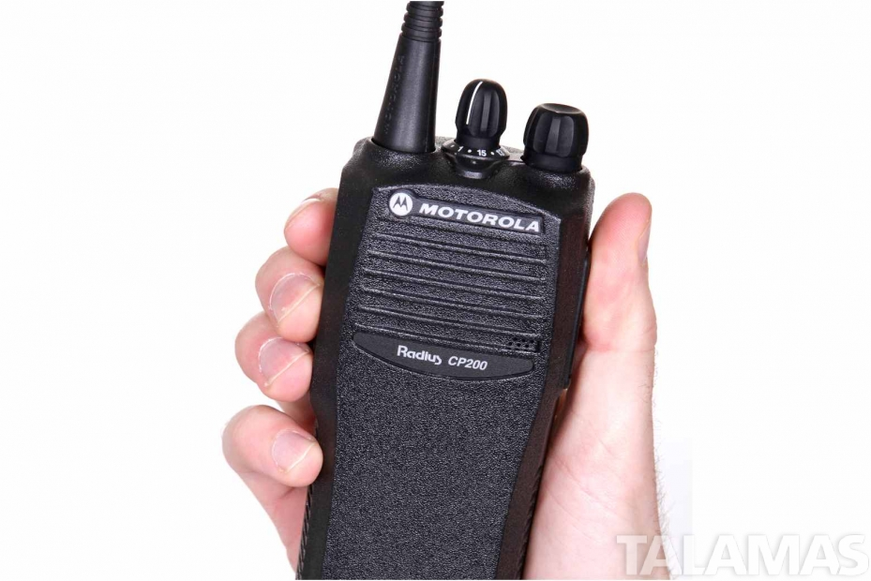
It is human nature in emergency situations for people to feel immediately uncomfortable.
It is normal for emergency situations to feel chaotic.
Take a deep breath.
Remind yourself that you are okay.
Don’t panic.
Call for help.

Slide 5

Code Blue – Medical Emergency
Call “Code Blue” three times on the radio. Give the location. Stay with the victim to give information.
Office or store will call 911.
Managers will come immediately to give assistance.
Store/maintenance staff goes to street to direct paramedics and managers will control guests away from site of emergency.
If in the tower, the tower closes until the emergency is over.

Slide 6
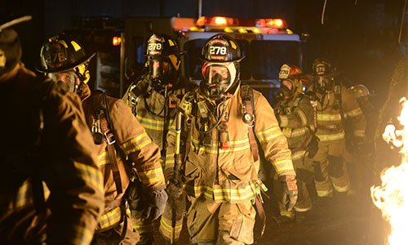
Code Red – Fire, Chemical Spill, Bomb Threat
Evacuate. Call “Code Red” three times on radio and give location. Someone in office or store will call 911.
Utilize fire extinguishers if appropriate. Be available to give information to first responders.
Maintain safe distance.

Slide 7
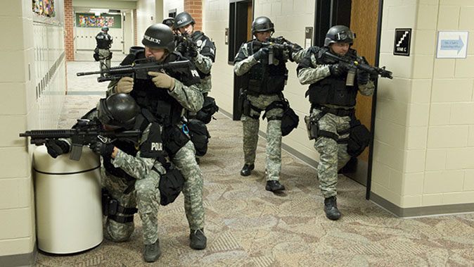

Code Alpha – Active Shooter on property
Call Code Alpha three times on the radio and give location. Instruct to evacuate to opposite end of the property from the active shooter.
Staff assist guests through gates.
Run, hide, fight protocol.

Slide 8


Code Nemo – Lost Child
Call Code Nemo on radio three times. Give a description of the child and last seen location.
Site Lock-Down: *it is illegal to hold anyone against their will on property or to put your hands on them. Monitor front porch for people leaving watching specifically for the child.
Management staff to front porch of VC to manage visual lock-down.

Slide 9
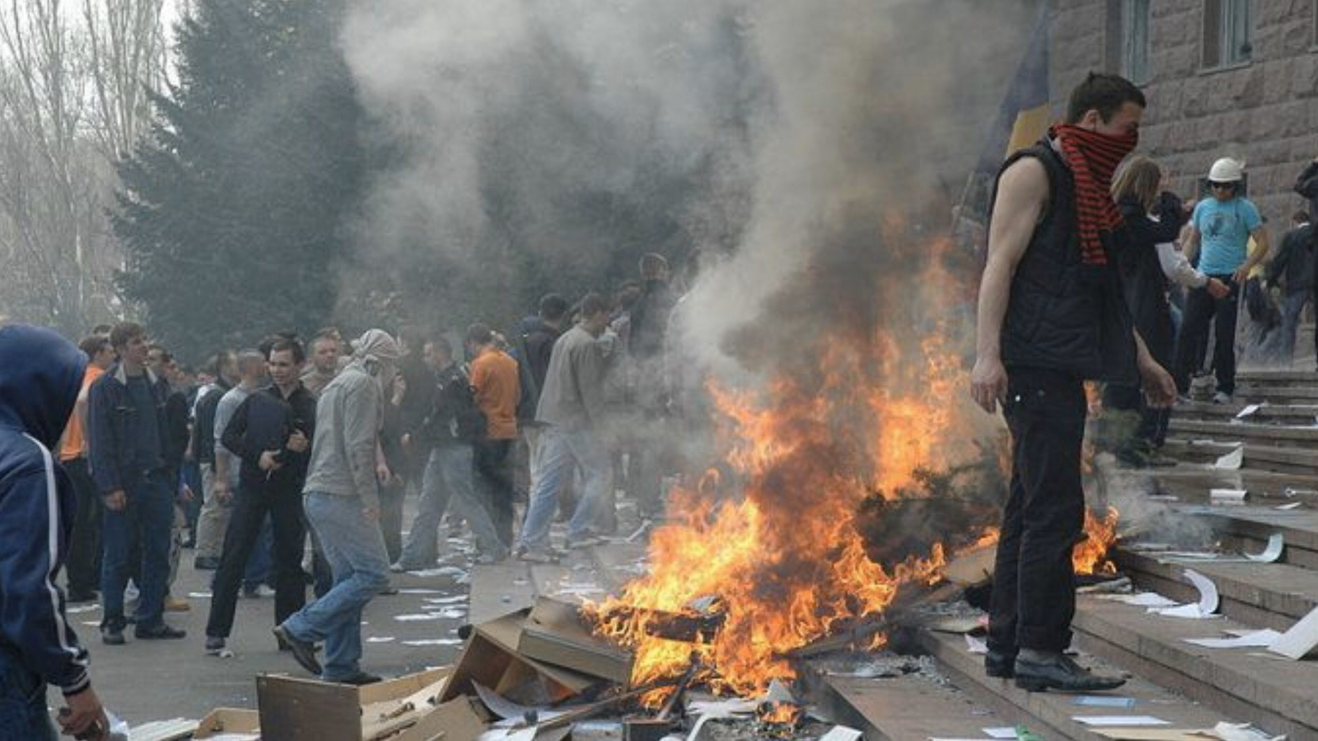
Code Black – Civil Unrest
Lock-down to prevent potential violence from entering property
Code Orange – County Emergency Management Ordered Lock - Down

Slide 10
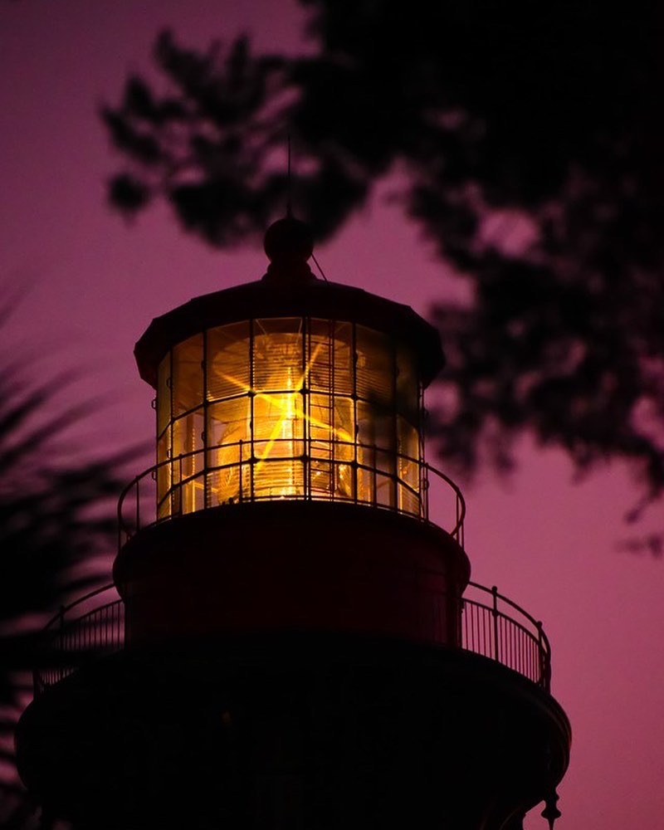
Code Green – All Clear
Resume normal operations

Slide 11

Birthdays & Anniversaries & New Hires
January
Kelcie Lloyd 7th
Tresa Calfee 9th
Karen Moore 10th
Greg Nagel 15th
Renee Unsworth 24th
Kathy Fleming 25th
Andrew Thomson 27th
Jason Titcomb 29th
Lee Capitano 11 yrs
Paula Ostholthoff 1yr
Karen Moore
Barbara Byer

Slide 12
Quarter Drawing Winners
Miranda & John

